Slide 1
FINAL REVIEW COGNITIVE TASK CLASSIFICATION USING EEG SIGNALS WITH DEEP NEURAL NETWORKS
PROJECT ID: BDE-5
TEAM MEMBERS
SATHYA NARAYANA O R - 21BLC1157
BHUVAN D - 21BLC1201
DHARANIDHARAN S I – 21BLC1661
GUIDE
DR. SUCHETHA M – SENSE

Slide 2
INTRODUCTION
EEG Signals help us to understand brain activity during tasks like focusing, remembering, and problem-solving.
Deep Learning makes analyzing EEG data faster, more accurate, and automatic.
This approach enables brain-computer interfaces and personalized brain training systems.

Slide 3
PROBLEM STATEMENT
EEG signals are hard to understand because they have a lot of data, noise, and tricky patterns.
Old methods use manual features and often don't work well with different types of data.
Our goal is to use a deep neural network to automatically find important patterns and classify cognitive tasks more accurately, improving brain research and technology interaction.

Slide 4
RESEARCH OBJECTIVES
Build a system using deep neural networks to classify cognitive tasks from EEG signals.
Improve accuracy by outperforming traditional classification methods.
Enable real-world use in brain-computer interfaces and cognitive monitoring.
Analyze brain activity to gain insights into tasks like focus, memory, attention and problem-solving.

Slide 5
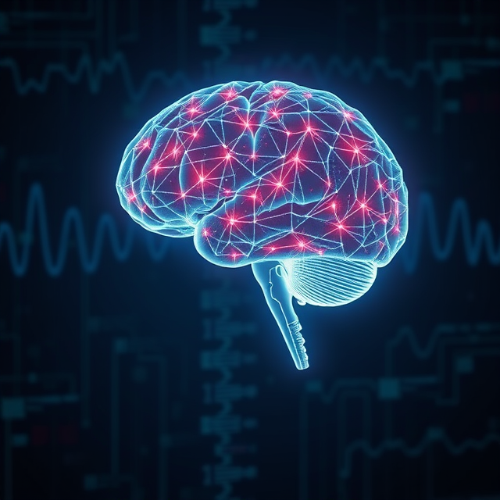
Cognitive Tasks Overview:
Here is the overview about the Cognitive tasks we are working with:
HVLT (Verbal Learning Task): Assesses verbal memory and recall.
Stroop Test: Evaluates attention and cognitive flexibility.
Symbol Digit Modalities: Measures processing speed and attention.
COWAT (Verbal Fluency Task): Tests verbal fluency and executive function.
Trail Making Task: Assesses visual attention and task-switching.
Digit Span Test: Evaluates working memory and attention.
Delayed HVLT: Tests delayed verbal recall and memory retention.
ModBent Task: Focuses on emotion recognition and processing.
Baseline: Serves as a resting state reference for comparison.

Slide 6
METHODOLOGY APPROACH- I
Data Collection and analysis:
Signals: 81 EEG signals recorded from 81 subjects.
Each recorded from 16 channels at 250 Hz sampling rate.
Folders: MAT (EEG data), LAY (task timestamps).
Tasks: 8 cognitive tasks + baseline (e.g., HVLT, Stroop Test).
Channels: {'T5', 'T6', 'T3', 'T4', 'F7', 'F8', 'O1', 'O2', 'P3', 'P4', 'C3', 'C4', 'F3', 'F4', 'Fp1', 'Fp2'}.

Slide 7
Preprocessing:
Segregated EEG signals based on task timestamps from LAY files.
Extracted relevant time intervals from raw EEG signals for each task.
Spectrogram Generation:
Frequency-time spectrograms generated for each EEG signal using the Short-Time Fourier Transform (STFT) method.
Analyze the relationship between EEG channels for further exploration (e.g., PAC) using concepts of Cross Frequency Coupling.
Task-Specific Analysis:
Create spectrograms for each cognitive task (e.g., HVLT, Stroop, COWAT, etc).
Focused on extracting frequency and time-domain features to use as input for deep learning models.

Slide 8
Cross-Frequency Coupling (PAC):
Explore potential relationships between EEG channels using Cross-Frequency Coupling methods like Phase Amplitude Coupling (PAC).
Investigating PAC can help model the connectivity between brain regions.
PAC features like calculating the Modulation Index can help analyze the relationship between the cross channels for each task on a 16x16 grid as a PAC Interchannel distribution .
Deep Learning Approach:
Time-frequency spectrogram images and phase-amplitude coupling heatmaps both types of images was embedded and given as Dual input for MobileNetV2 Deep Learning Model .
The goal is to classify cognitive tasks based on EEG signals.

Slide 9
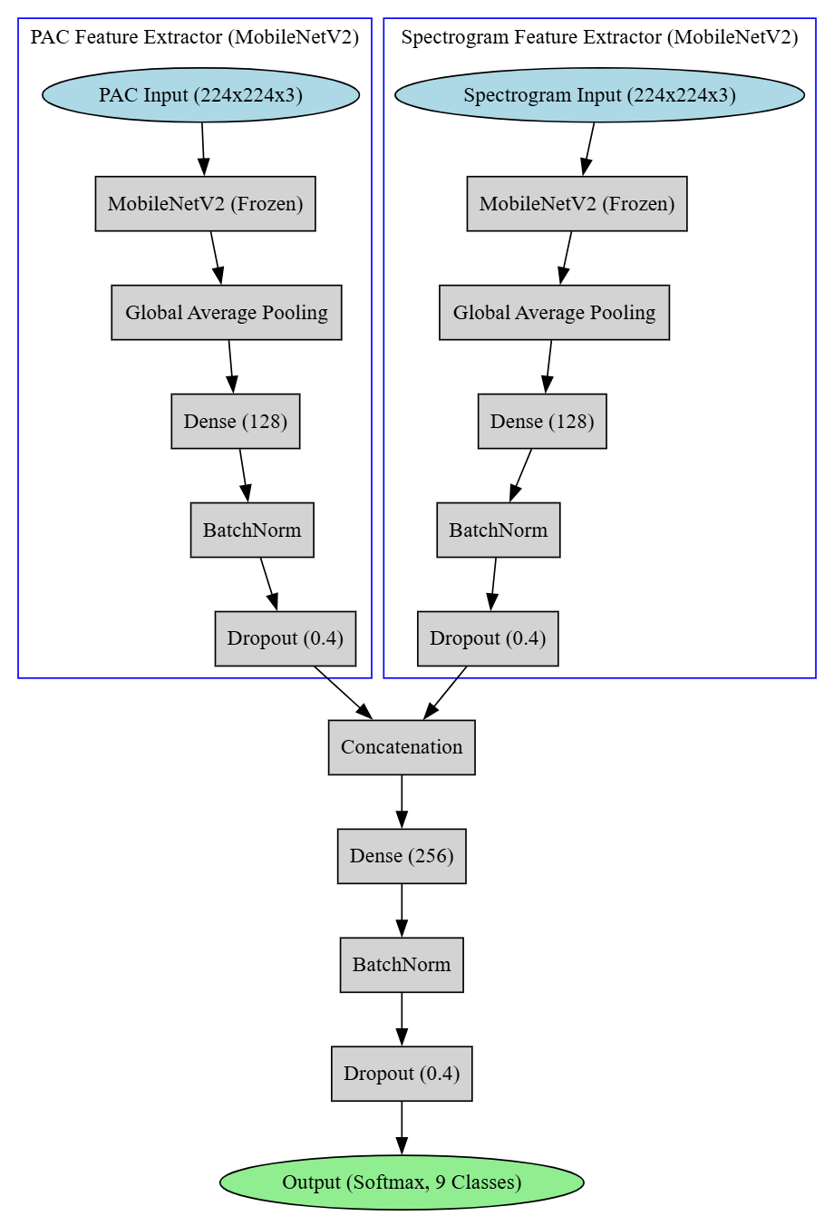
Custom Design System Architecture of MobileNet-V2

Slide 10
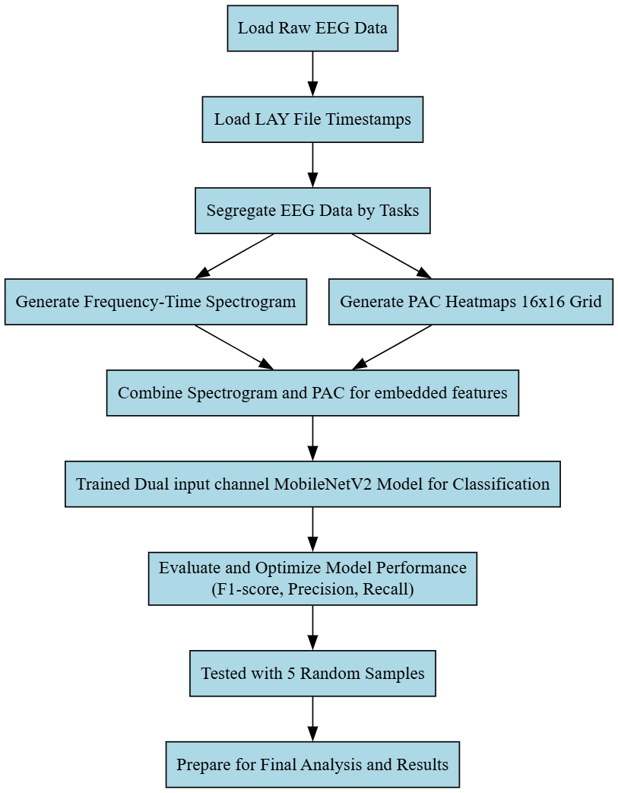
Implementation of Approach - I using MobileNet-V2

Slide 11
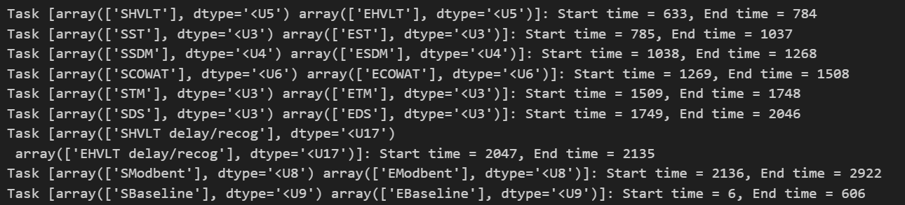
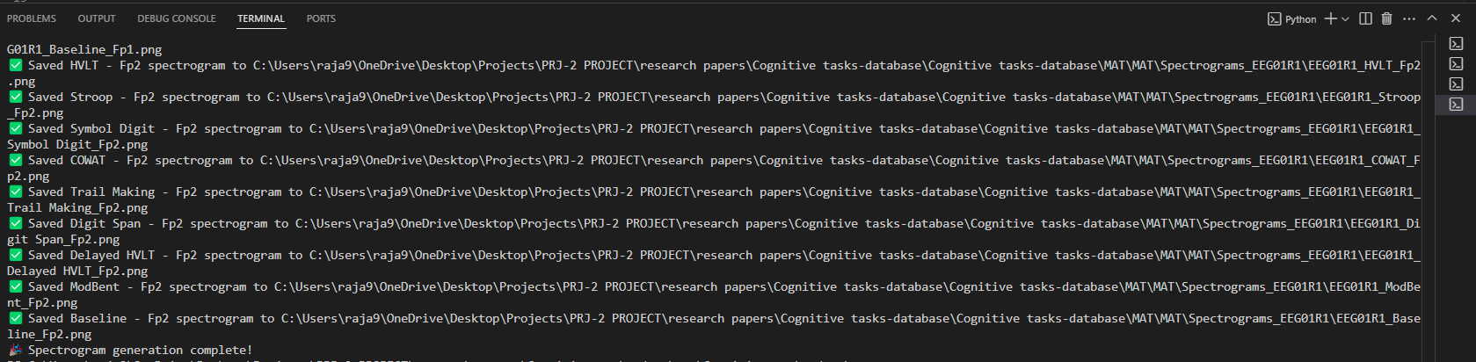
Segregation of each EEG signals as per task with help of Time phases given in LAY file:
Each Task EEG is stored in an output folder as spectrogram images:

Slide 12
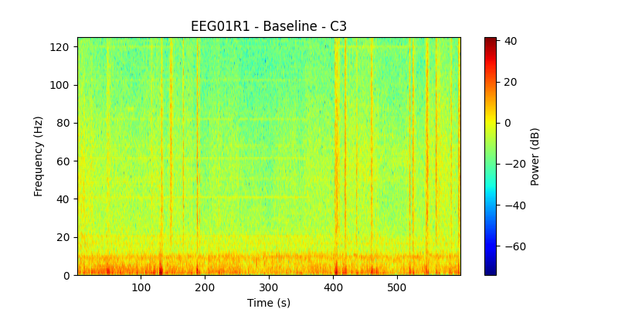
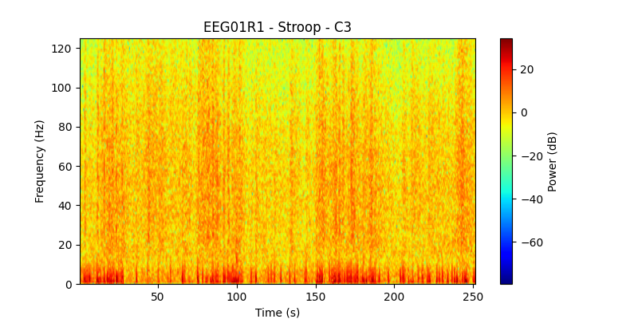
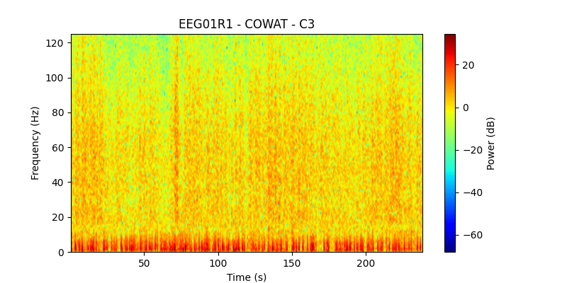
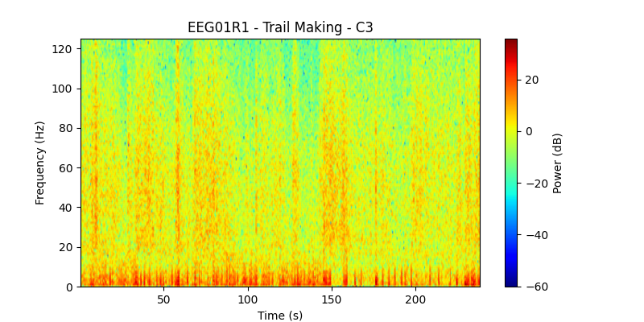
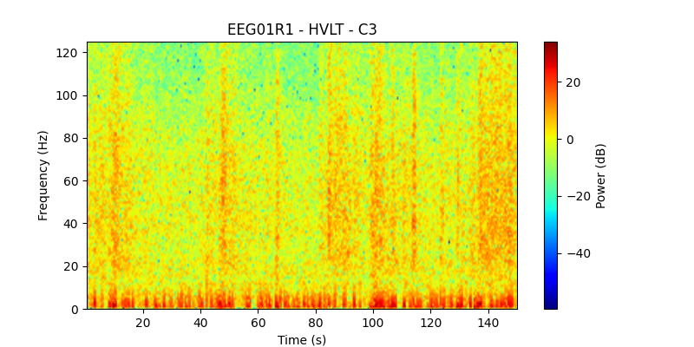
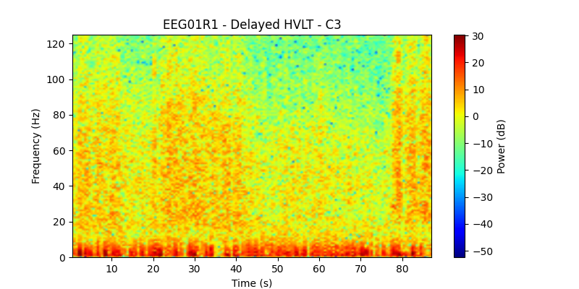
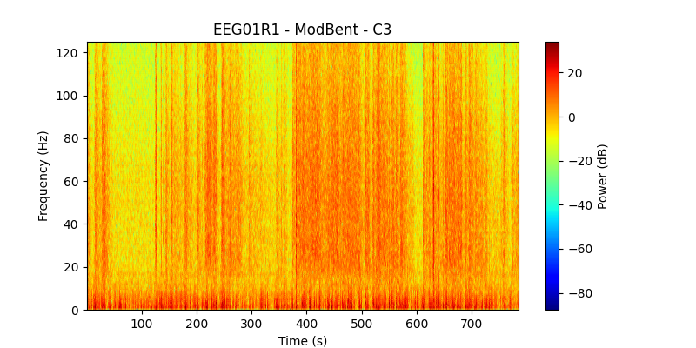
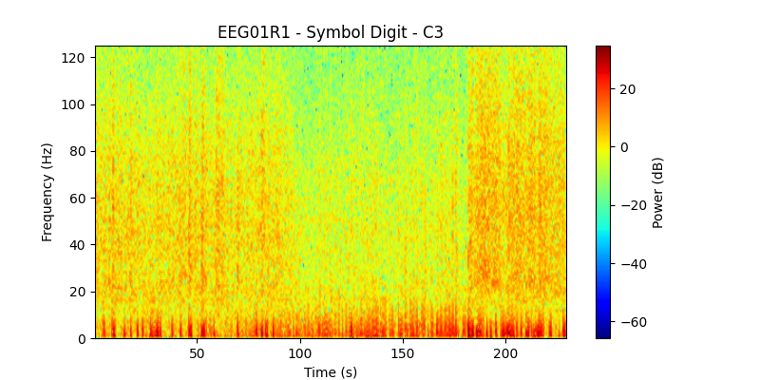
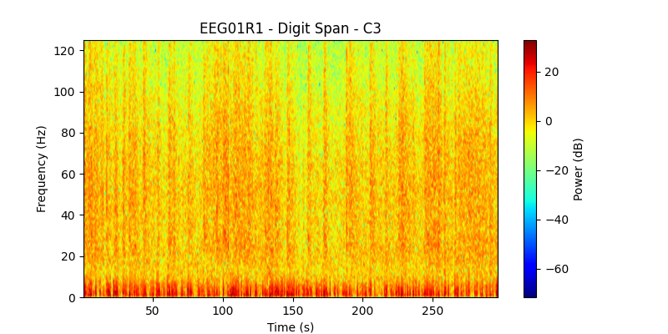
Frequency-Time spectrogram of 9 tasks of one channel C3:

Slide 13
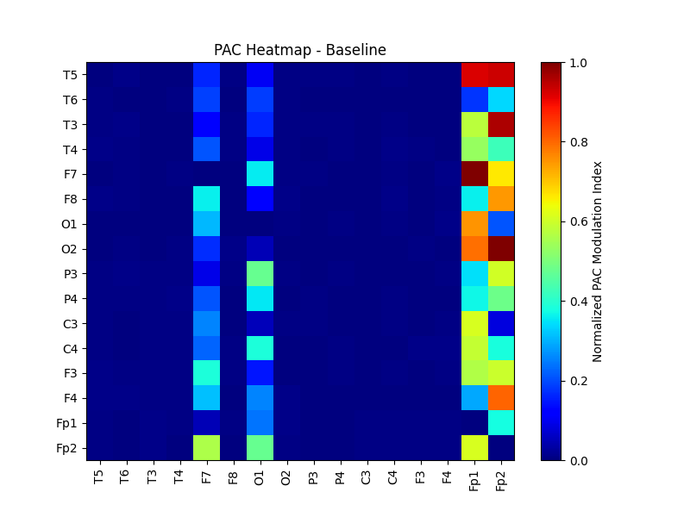
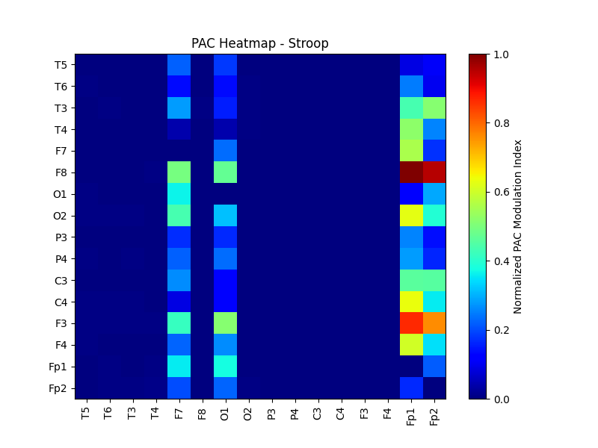
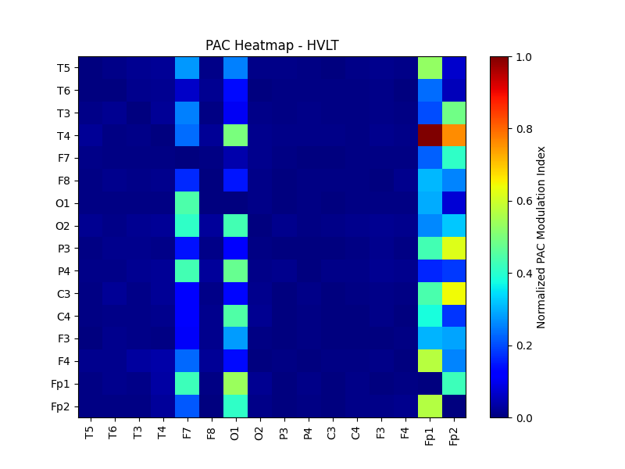
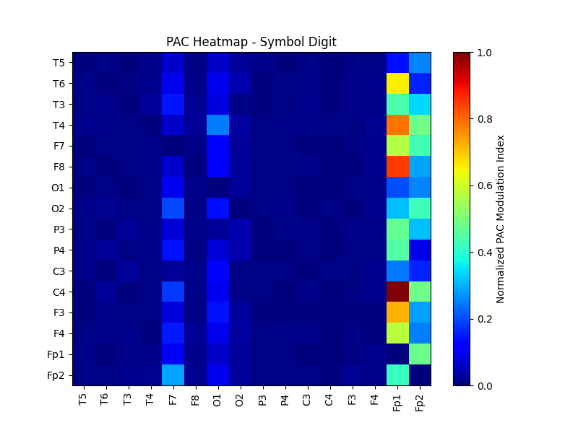
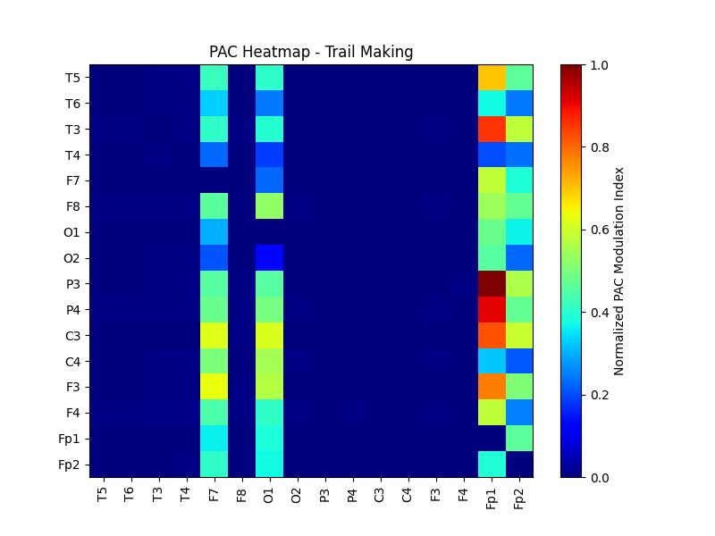
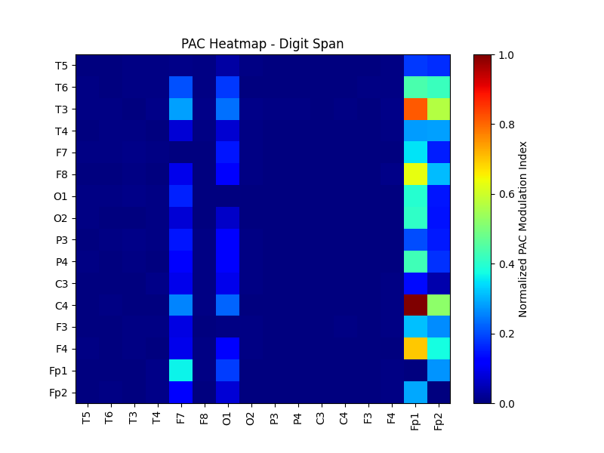
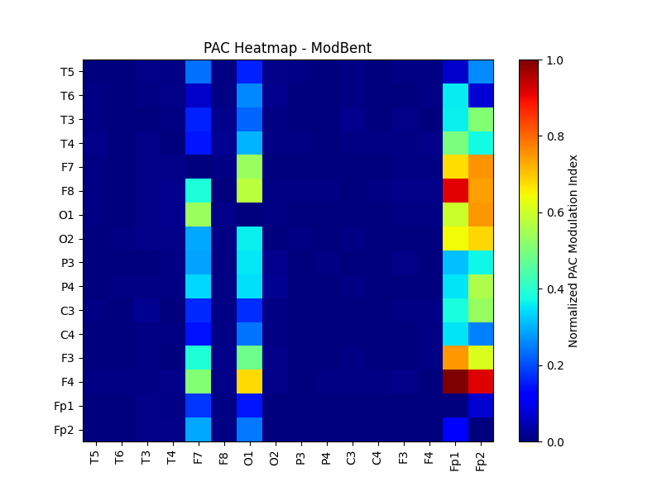
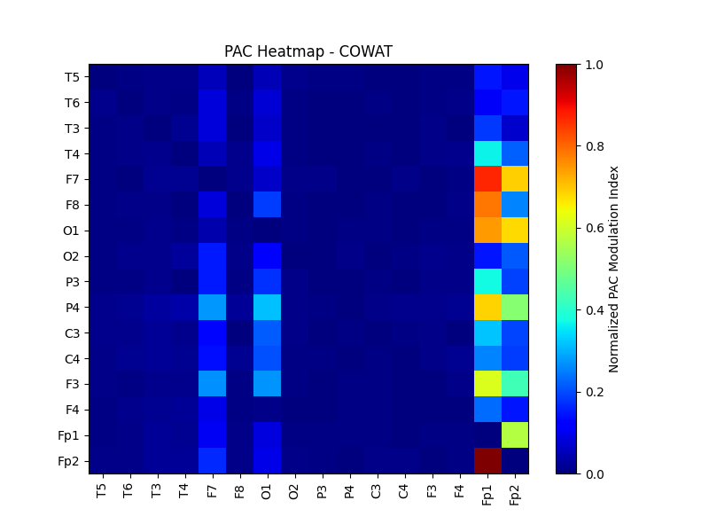
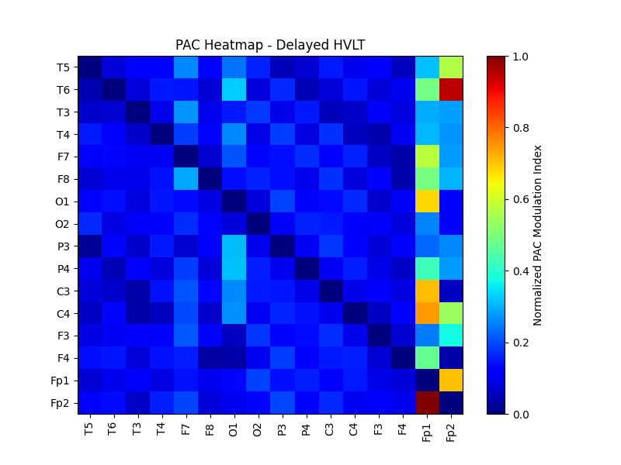
Visualization of Interchannel distribution of PAC using heatmap of all 9 tasks :

Slide 14
APPROACH 2 (USING EEG AS NUMERICAL DATA)
Preprocessing and Segmentation :
Segregated EEG signals based on task timestamps from LAY files.
Extracted relevant time intervals from raw EEG signals for each task.
Segmented each subject signal into its respective 9 tasks and stored them as Numpy array of dimension (16,time) where 16 refers to the 16 electrodes i.e.{'T5', 'T6', 'T3', 'T4', 'F7', 'F8', 'O1', 'O2', 'P3', 'P4', 'C3', 'C4', 'F3', 'F4', 'Fp1', 'Fp2'}.
EEG signal filtering:
Bandpass Filtering: EEG signals were filtered into specific phase and amplitude bands based on task-relevant frequency ranges (e.g., Theta-Gamma, Alpha-Beta) used kaiser window.
Hilbert Transform: Applied to extract the instantaneous phase and amplitude for phase-amplitude coupling (PAC) computation.
PAC feature extraction:
Used PAC concept to compute the Modulation Index(MI) using Tort’s method.
Defined 9 phases band and 38 amplitude band computed 9*38=342 features for each electrodes so for each task since we have 16 channels we get around 16*342 numerical data stored as Numpy array for each task each subject.

Slide 15
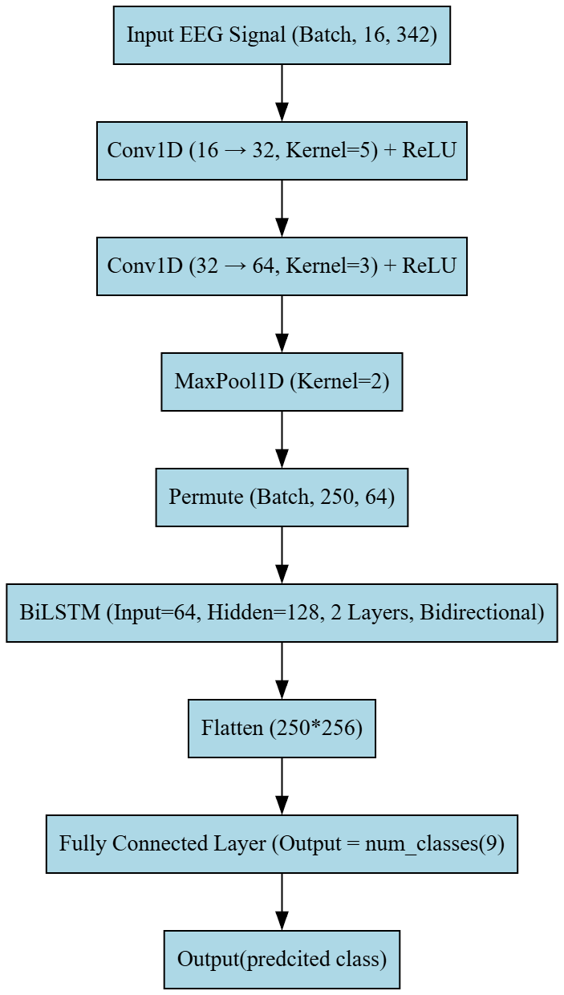
Deep Learning Approach using the generated MI numerical features:
We used an (CNN + BiLSTM) Hybrid model: The model extracts spatial features using 1D CNN layers and learns temporal dependencies using a BiLSTM network, making it effective for EEG sequence analysis .
Here is the custom architecture we used.
BiLSTM- Bidirectional Long Term short memory

Slide 16
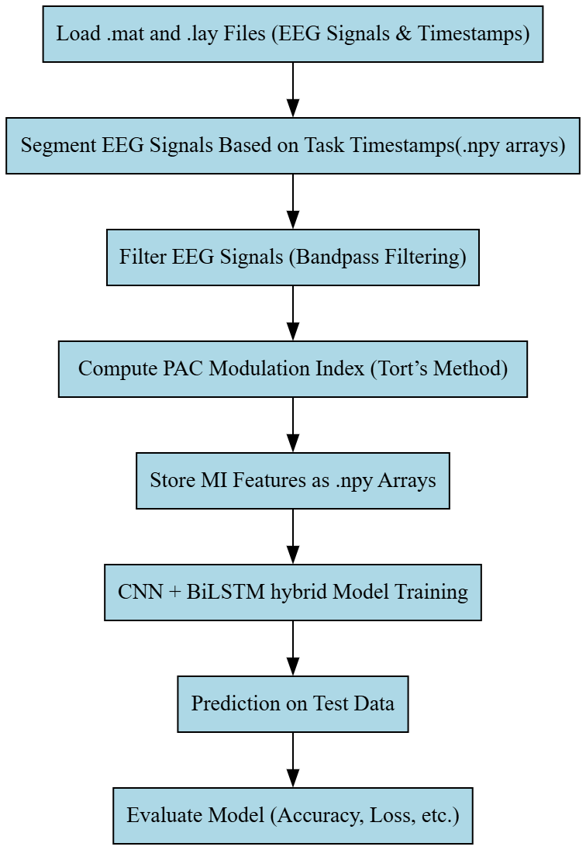
Implementation of Approach - 2

Slide 17
EVALUATION METRICS TABLE FOR APPROACH 1
 | PRECISION | RECALL | F1-SCORE | SUPPORT
BASELINE | 0.86 | 0.62 | 0.72 | 29
COWAT | 0.22 | 0.31 | 0.26 | 29
DELAYED HVLT | 0.38 | 0.57 | 0.45 | 30
DIGITSPAN | 0.35 | 0.23 | 0.28 | 30
HVLT | 0.40 | 0.20 | 0/27 | 30
MODBENT | 0.37 | 0.39 | 0.38 | 28
STROOP | 0.48 | 0.33 | 0.39 | 30
SYMBOL DIGIT | 0.25 | 0.43 | 0.32 | 28
TRAIL MARKING | 0.32 | 0.34 | 0.27 | 29
ACCURACY |  |  | 0.37 | 263
MACRO AVG | 0.40 | 0.37 | 0.37 | 263
WEIGHTED AVG | 0.40 | 0.37 | 0.37 | 263

Slide 18
OVERALL VALUES OF THE EVALUATION METRICS OF APPROACH-1
EVALUATION METRICS | VALUES
ACCURACY | 0.37
PRECISION | 0.40
F1-SCORE | 0.37
RECALL | 0.37

Slide 19
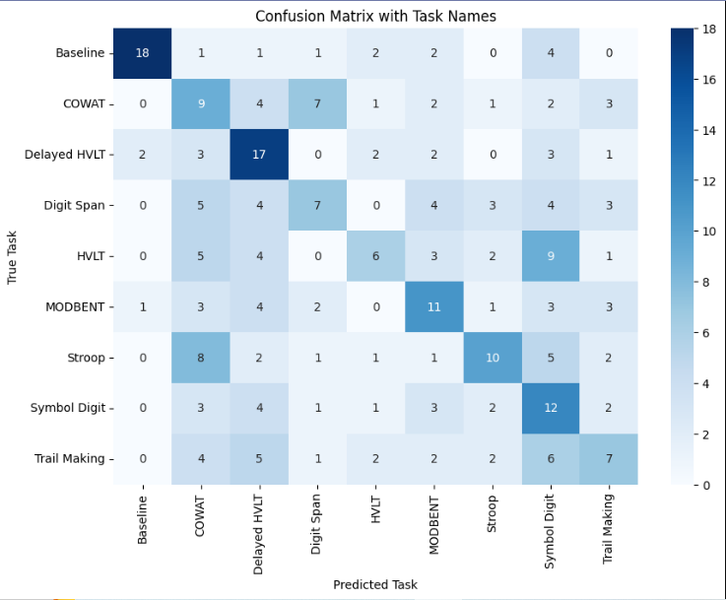
RESULTS OF APPROACH 1

Slide 20
EVALUATION METRICS OF APPROACH-2
EVALUATION METRICS | VALUES
ACCURACY | 0.74
PRECISION | 0.76
F1-SCORE | 0.74
RECALL | 0.74

Slide 21
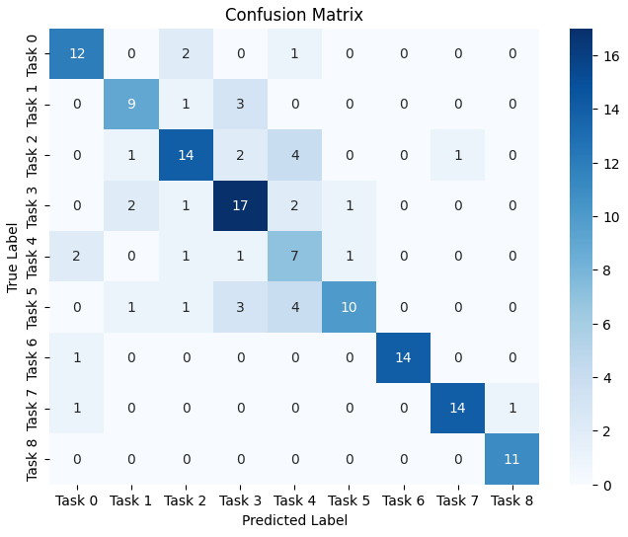
RESULTS OF APPROACH 2

Slide 22
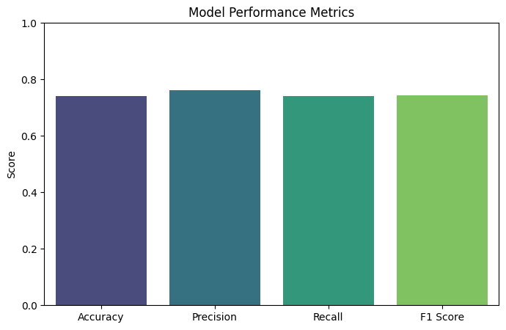

Slide 23
PERFORMANCE ANALYSIS OF THE TWO APPROACHES:
EVALUATION METRICS | APPROACH-1 | APPROACH-2
ACCURACY | 0.37 | 0.74
PRECISION | 0.40 | 0.76
F1-SCORE | 0.37 | 0.74
RECALL | 0.37 | 0.74

Slide 24
APPROACH- I With Only 3 Classes
Preprocessing:
Segregated EEG signals based on task timestamps from LAY files.
Extracted relevant time intervals from raw EEG signals for each task.
Spectrogram Generation:
Frequency-time spectrograms generated for each EEG signal using the Short-Time Fourier Transform (STFT) method.
Analyze the relationship between EEG channels for further exploration (e.g., PAC) using concepts of Cross Frequency Coupling.
Task-Specific Analysis:
Create spectrograms for each cognitive task (e.g., HVLT, Stroop and Baseline).
Focused on extracting frequency and time-domain features to use as input for deep learning models.

Slide 25
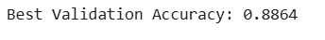
EVALUATION METRICS TABLE FOR APPROACH 1 – With 3 Classes
 | PRECISION | RECALL | F1-SCORE | SUPPORT
BASELINE | 1.00 | 0.93 | 0.96 | 14
STROOP | 1.00 | 0.67 | 0.80 | 15
HVLT | 0.71 | 1.00 | 0.83 | 15
ACCURACY |  |  | 0.86 | 44
MACRO AVG | 0.90 | 0.87 | 0.87 | 44
WEIGHTED AVG | 0.90 | 0.86 | 0.86 | 44

Slide 26
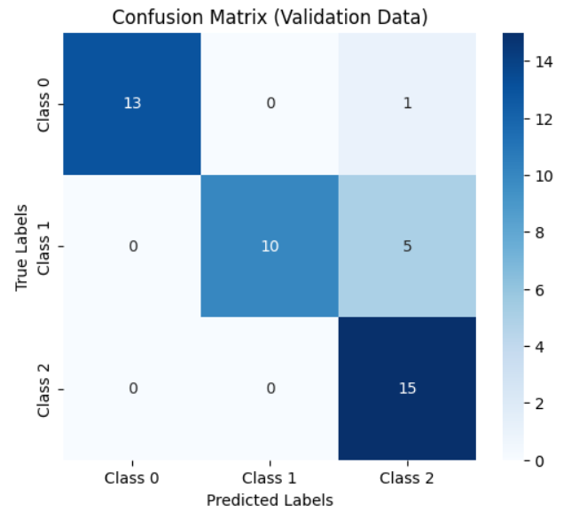
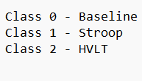
RESULTS OF APPROACH – 1 With 3 Classes

Slide 27
OVERALL VALUES OF THE EVALUATION METRICS OF APPROACH-1 With 3 Classes
EVALUATION METRICS | VALUES
ACCURACY | 0.86
PRECISION | 0.93
F1-SCORE | 0.86
RECALL | 0.86

Slide 28
CONCLUSION AND FUTURE WORKS
Conclusion:
Deep learning models can accurately recognize different cognitive tasks from EEG signals by using spectrogram and PAC features.
Combining these features improves accuracy, showing that deep neural networks can be useful in brain research and brain-computer interfaces.
Future Work:
Enhancing model performance by exploring additional feature extraction methods
Expanding the dataset to improve the generalizability and robustness of the deep learning model.

Slide 29
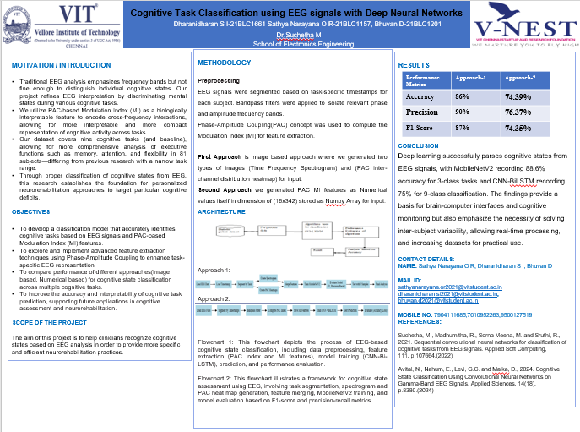

Slide 30
Thank You

